Slide 1
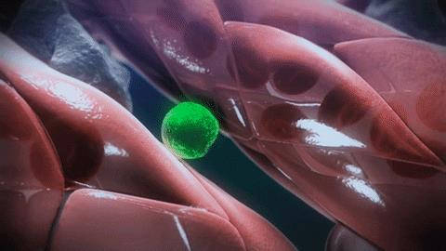
GAC 175: BIOLOGICAL CHEMISTRY
Amma A Larbi, PhD
Department of Biochemistry and Biotechnology,
Office: SCB, RM 11 ammalarbi@gmail.com

Slide 2
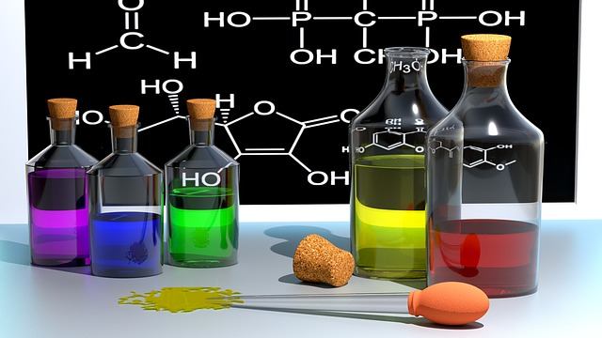
SOLUBILITY

Slide 3
Introduction
Solution - homogeneous mixture
Solute - substance being dissolved
Solvent - present in greater amount

Slide 4
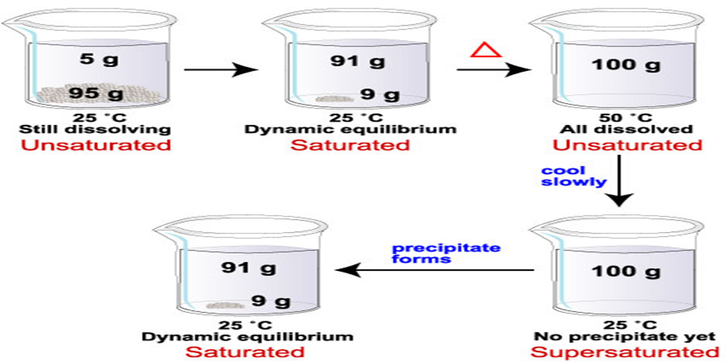
Introduction continued
Degree of Saturation

Slide 5
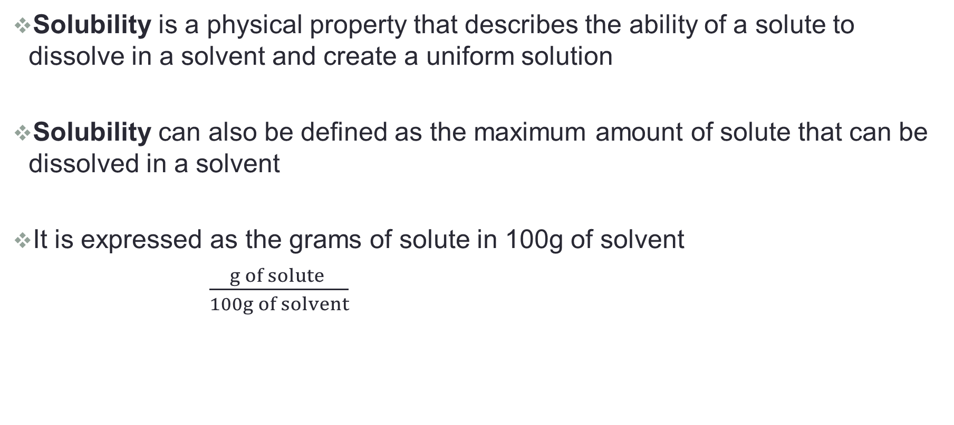
Introduction continued
Solubility is a physical property that describes the ability of a solute to dissolve in a solvent and create a uniform solution
Solubility can also be defined as the maximum amount of solute that can be dissolved in a solvent
It is expressed as the grams of solute in 100g of solvent
$\frac{g of solute }{100g of solvent}$

Slide 6
Factors That Affect Solubility
Temperature
The solubility of a solid in a liquid is significantly affected by temperature changes.
Higher temperatures provide more kinetic energy, allowing solid particles to break away from the crystal lattice and dissolve more easily
Solubility of gases in liquids decreases with rise in temperature. When dissolved, the gas molecules are present in liquid phase and the process of dissolution can be considered similar to condensation and heat is evolved in this process.

Slide 7
Solubility vs. Temperature
200
180
160
KI
KNO₃
140
120
Solubility (g solute / 100 g H₂O)
NaNO₃
100
80
60
Na₃PO₄
40
NaCl
20
0
20
40
60
80
100
Temperature (ºC)
Timberlake, Chemistry 7th Edition, page 297
Notes:
The general rule of thumb is that solubility of solids increases with increases in temperature.
Maximum amount of a solute that can dissolve in a solvent at a specified temperature and pressure is its solubility.
– Solubility is expressed as the mass of solute per volume (g/L) or mass of solute per mass of solvent (g/g) or as the moles of solute per volume (mol/L).
– Solubility of a substance depends on energetic factors and on the temperature and, for gases, the pressure.
• A solution that contains the maximum possible amount of solute is saturated.
• If a solution contains less than the maximum amount of solute, it is unsaturated.
When a solution is saturated and excess solute is present, the rate of dissolution is equal to the rate of crystallization.
• Solubility increases with increasing temperature — a saturated solution that was prepared at a higher temperature contains more dissolved solute than it would contain at a lower temperature, when the solution is cooled, it can become supersaturated.
Solubility of a substance generally increases with increasing temperature
No relationship between the structure of a substance and the temperature dependence of its solubility
Solubility may increase or decrease with temperature; the magnitude of this temperature dependence varies widely among compounds
This variation of solubility with temperature is used to separate the components of a mixture by fractional crystallization, the separation of compounds based on their solubilities in a given solvent
Fractional crystallization is a common technique for purifying compounds; the compound of interest must be more soluble at high temperature than at low temperature, so that lowering the temperature causes it to crystallize out of solution
Solubility of gases in liquids decreases with increasing temperature
Attractive intermolecular interactions in the gas phase are essentially zero for most substances
When a gas dissolves, its molecules interact with solvent molecules and heat is released when these new attractive interactions form, therefore, dissolving most gases in liquids is an exothermic process (ΔH_{soln} < 0)
Adding heat to the solution provides thermal energy that overcomes the attractive forces between the gas and the solvent molecules, thereby decreasing the solubility of the gas

Slide 8
Factors Affecting Solubility
Pressure
Pressure does not have any significant effect on the solubility of solids in liquids. It is so because solids and liquids are highly incompressible and practically remain unaffected by changes in pressure.
The solubility of a gaseous solute increases with an increase in pressure to which the solution is exposed. Carbonated beverages provide a nice illustration of this relationship.
The carbonation process involves exposing the beverage to a relatively high pressure of carbon dioxide gas and then sealing the beverage container, thus saturating the beverage with CO2 at this pressure.

Slide 9
Pressure continued
When the beverage container is opened, a familiar hiss is heard as the carbon dioxide gas pressure is released, and some of the dissolved carbon dioxide is typically seen leaving solution in the form of bubbles

Slide 10
Factors Affecting Solubility
Nature of the solvent
Polar solvents
Polar solvents dissolve ionic solutes and other polar substances
Water dissolves phenols, alcohols and other oxygen and nitrogen-containing compounds that can form hydrogen bonds with water
The solubility of a substance also depends on the ratio of the polar to the nonpolar groups of the molecule
As the length of a nonpolar chain of an aliphatic alcohol increases, the solubility of the compound in water decreases

Slide 11
Polar solvents continued
When there are additional polar groups in the molecule, as found in propylene glycol, glycerin and tartaric acid, solubility in water increases greatly
Branching of carbon chains reduces the nonpolar effect and leads to an increase in solubility

Slide 12
Factors Affecting Solubility
Nonpolar solvents
Nonpolar solvents are unable to reduce the attraction between the ions of strong and weak electrolytes because of the solvent’s low dielectric constants
They are unable to form hydrogen bonds with nonelectrolytes
Nonpolar solvents can dissolve nonpolar solutes through weak van der Waals forces
Example; Solutions of fats and oils in carbon tetrachloride or benzene

Slide 13
Factors Affecting Solubility
Semipolar solvents
Semipolar solvents such as ketones can induce a certain degree of polarity in nonpolar solvents. For example, benzene is readily polarizable, and becomes soluble in alcohol
They can act as intermediate solvents to bring about miscibility in polar and nonpolar liquids
Example: Acetone increases the solubility of ether in water
Propylene glycol has been shown to increase the mutual solubility of water and peppermint oil and of water and benzyl benzoate

Slide 14
Factors Affecting Solubility
Particle size
Molecular size affects solubility
The larger the molecule or the higher its molecular weight, the less soluble the substance
Larger molecules are more difficult to surround with solvent molecules to solvate the substance
In the case if organic compounds, the amount of carbon branches will increase the solubility since more branching will reduce the size of the molecule and make iit easier to solvate the molecules with the solvent

Slide 15
Methods of Expressing Concentration of Solutions
Mole fraction ( X )
It is defined as the ratio of the number of moles of a component to the total number of moles of all the components.
Mole fraction gives the concentration as the as the ratio of moles of one component to the total moles of present in the solution.
For a binary solution, if the number of moles of A and B are nA and nB respectively, the mole fraction of A will be
X _{A}= n_{A}/n_{A}+n_{B}
X B= nB/nA+nB

Slide 16
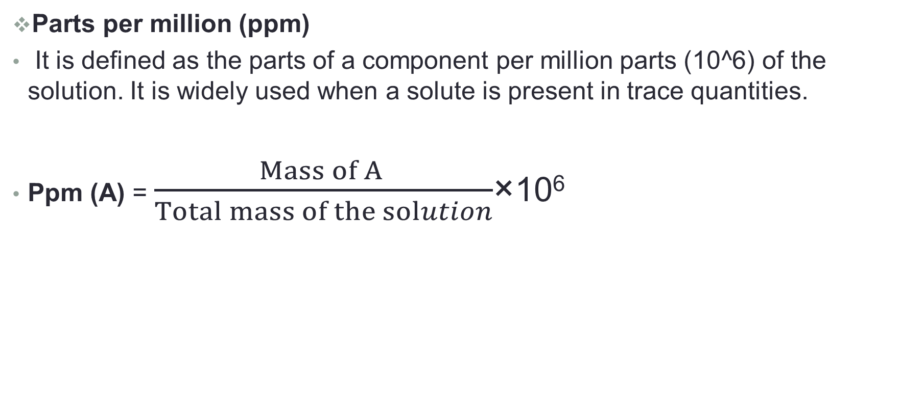
Methods of Expressing Concentration of Solutions continued
Parts per million (ppm)
It is defined as the parts of a component per million parts (10^6) of the solution. It is widely used when a solute is present in trace quantities.
Ppm (A) = $\frac{Mass of A }{Total mass of the solution}$×10⁶

Slide 17
Methods of Expressing Concentration of Solutions continued
Molarity (M)
One of the most commonly used methods for expressing the concentrations is molarity. It is the number of moles of solute dissolved in one liter of a solution.
Suppose a solution of ethanol is marked 0.25 M, this means that in one liter of the given solution 0.25 moles of ethanol is dissolved.
Molarity (M) = Moles of Solute/Volume of Solution in liters

Slide 18
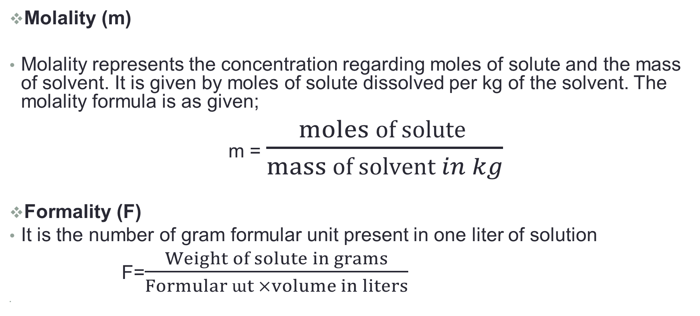
Methods of Expressing Concentration of Solutions continued
Molality (m)
Molality represents the concentration regarding moles of solute and the mass of solvent. It is given by moles of solute dissolved per kg of the solvent. The molality formula is as given;
m = $\frac{moles of solute }{mass of solvent in kg}$
Formality (F)
It is the number of gram formular unit present in one liter of solution
F=$\frac{Weight of solute in grams}{Formular ɯt ×volume in liters}$

Slide 19
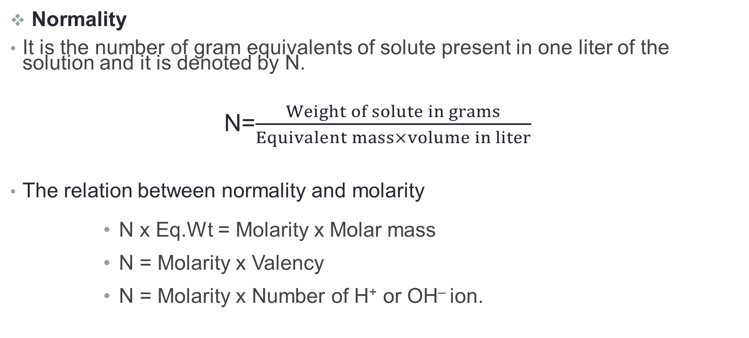
Methods of Expressing Concentration of Solutions continued
Normality
It is the number of gram equivalents of solute present in one liter of the solution and it is denoted by N.
N=$\frac{Weight of solute in grams}{Equivalent mass×volume in liter}$
The relation between normality and molarity
N x Eq.Wt = Molarity x Molar mass
N = Molarity x Valency
N = Molarity x Number of H⁺ or OH– ion.

